Slide 1
MMF Asset management© Global Macro Portfolios
Junhao wang, rogelo mAgos, jian wang, lucas krenn

Slide 2
motivation

Slide 3

Motivation
Diversification is one of the most powerful concepts in finance
Passive “long humanity” position
There are many areas open for diversification including:
Sector diversification (Industrials, Tech, Cyclicals, …)
Geographic diversification (USA, EMEA, APAC, …)
Asset diversification (Equities, Fixed Income, Commodities, …)
Many retail investors and everyday people fail to understand the aphorism “Don’t put all your eggs in one basket”
DOGE, GME, AMC

Slide 4
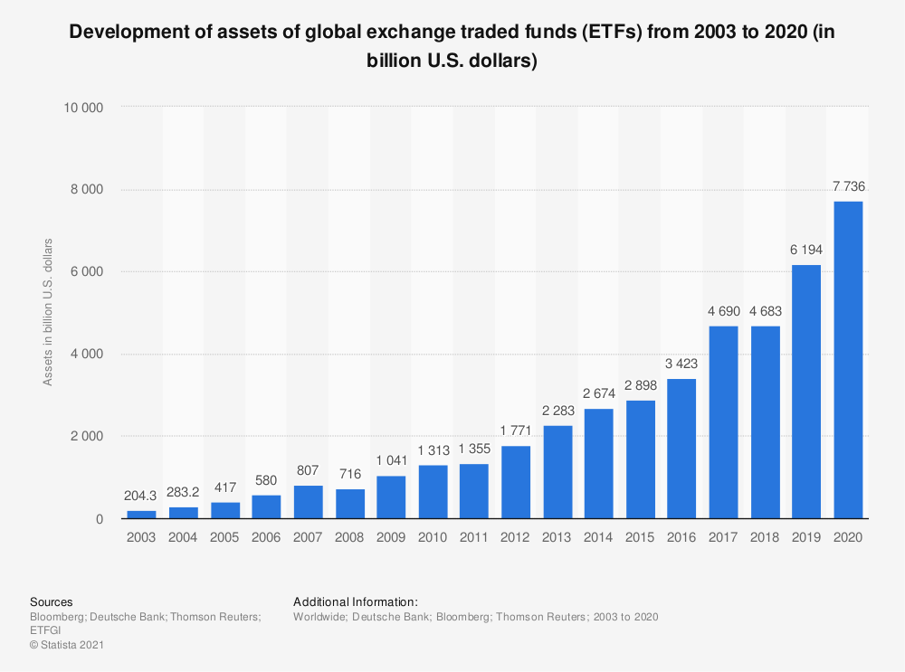
Motivation
Diversification is now cheaper and more accessible than ever thanks to the advent of Exchange-Traded Funds (ETFs)
ETFs are baskets of stocks/bonds/commodities/etc. packaged into a single financial instrument
Two types: passive and active
The usefulness of ETFs has been validated by rapid growth
Growth introduces innovation, ultimately pushing costs down for investors

Slide 5
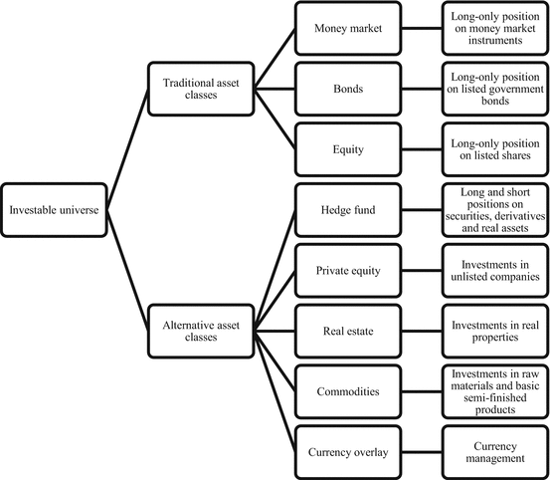
Motivation
The idea behind our strategy is to take advantage of all this innovation by packaging ETFs of all types into one easy-to-manage strategy
This way, investors can get exposure to products that they could not otherwise trade (fixed income, credit, commodities)
Moreover, they can also gain exposure to equity universes that may be seen as unconventional
Water ETFs
Psychedelics ETFs
Etc.

Slide 6
methodology

Slide 7


Methodology
We are mandated to have a 50/50 split of assets denominated in CAD/USD
Take advantage by buying the lowest cost/more traditional ETFs in USD
Alternative/niche ETFs in CAD
78 Canadian-listed ETFs
56 American-listed ETFs
Canadian ETFs include:
iShares Global Water Index ETF
Horizons S&P Green Bond Index ETF
Horizons Global Hydrogen Index ETF
American ETFs include:
iShares Global Water Index ETF
Horizons S&P Green Bond Index ETF
Horizons Global Hydrogen Index ETF

Slide 8
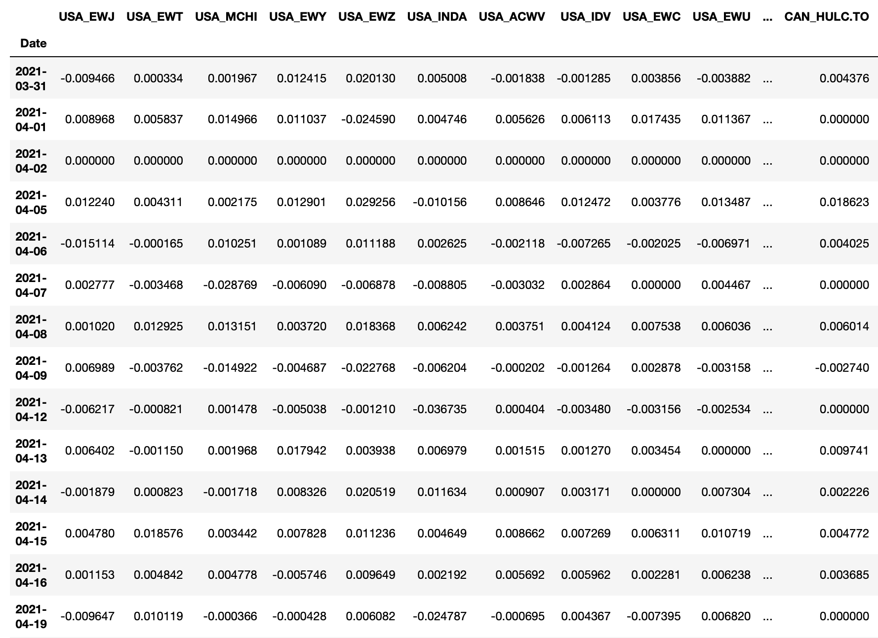
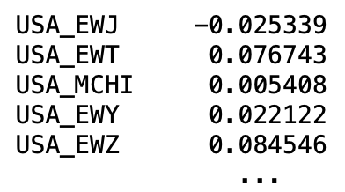
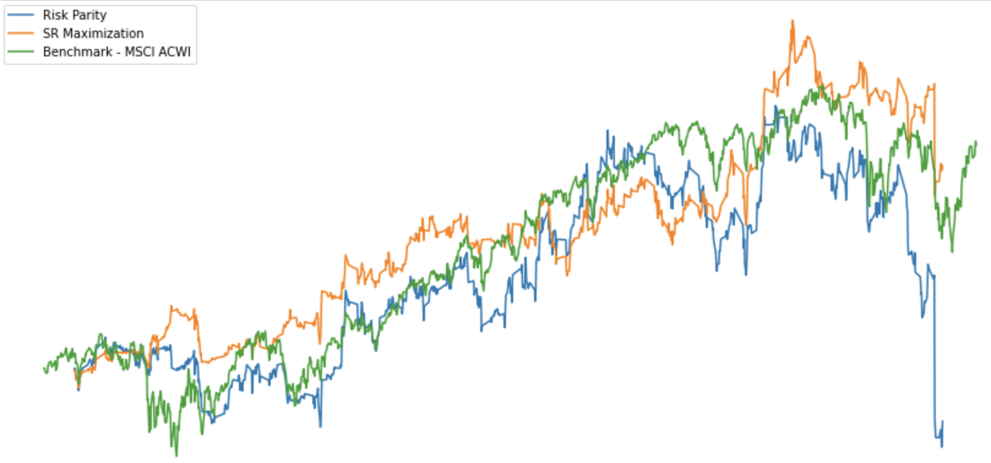
Methodology
First, import data from Yahoo! Finance using yfinance Python package
Next, divide data into subsections based on rebalancing period
t = 0
t = 1
t = 2…
Calculate returns for this period and repeat…
Calculate returns for this period and repeat…
Calculate correlation matrix, select x assets from each geography with lowest mean correlation…

Slide 9
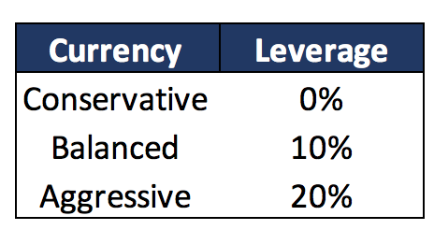
Option's strategy
We will take advantage of the possibility of using leverage and borrow money according to the risk profile of the client.
With the available cash we will buy Foreign exchange options (either calls or puts plain vanilla) in 8 different FX markets: Canadian Dollar (CAD), Mexican Peso (MXN), Brazial Real (BRL), Chinesse Yuan (CNY), Japanesse Yen (JPY), Euro (EUR), Russian Ruble (RUB), and South African Rand (ZAR).
We will use leverage according to the risk profile:

Slide 10
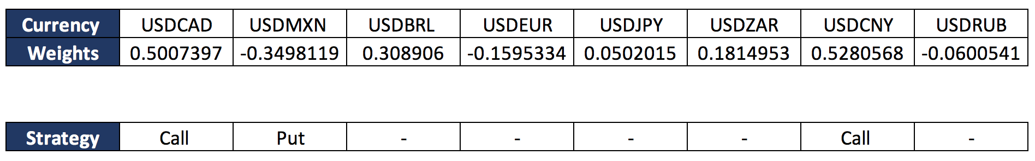
Option's strategy
At inception date and in every option's roll-over date, we will run a Max Sharpe Ratio optimization algorithm to obtain the weights of the portoflio. Then we order the weights in absolute value and choose a certain fixed number of them. Then, if the number is positive, the strategy will be a call, if negative, the strategy will be a put.
Example choosing 3 currencies

Slide 11
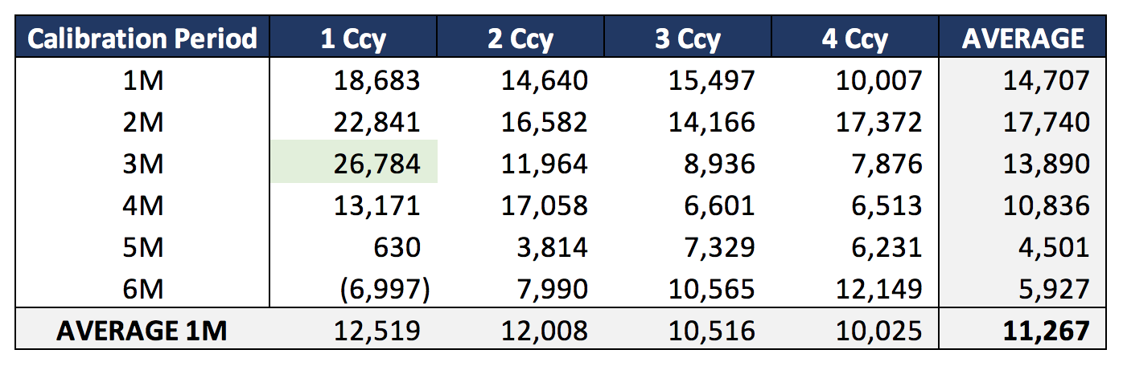
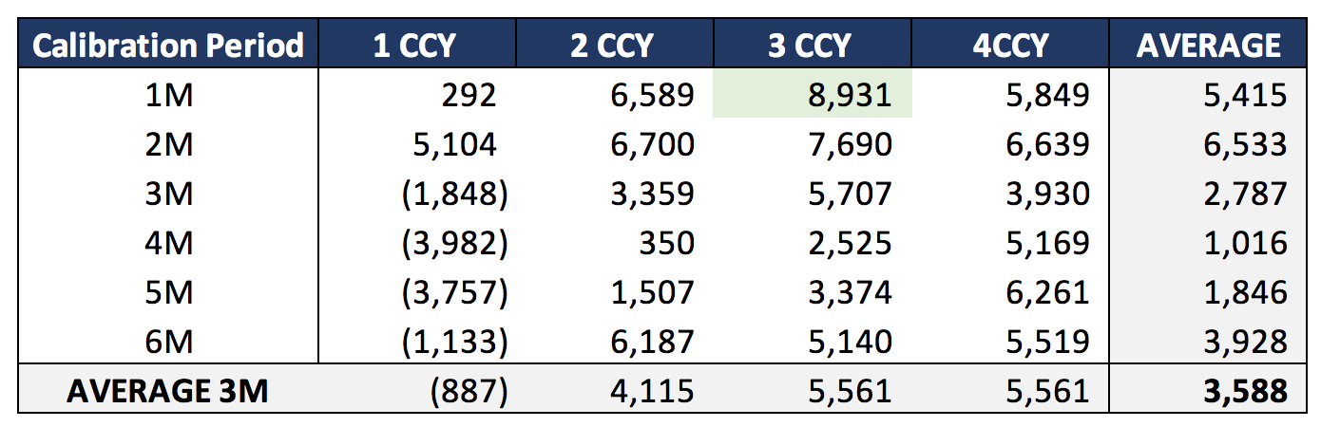
Backtesting – options strategy
Test Period
Start date: April 2011
End date: April 2016
Premium per period: 1k
1-month Options
3-month Options
Analyzing tenor of the option and the calibration period. Results show cumulative P&L

Slide 12
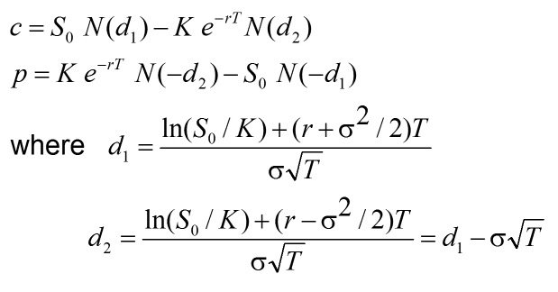
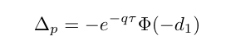
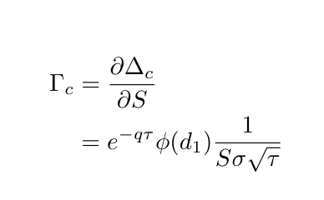
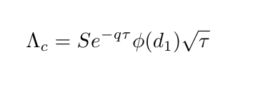
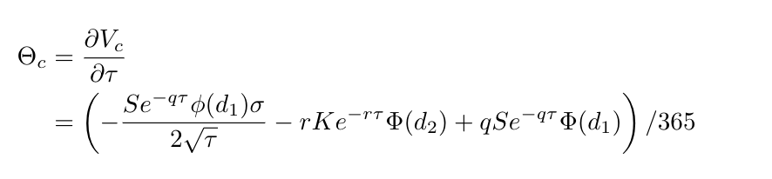
Methodology FX Options
IN THE FX OPTIONS MARKET IT'S BROADLY ACCEPTED THE BLACK-SCHOLES FRAMEWORK

Slide 13
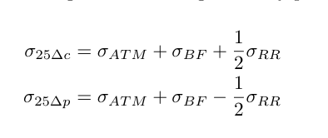
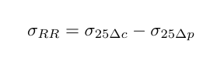
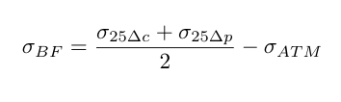
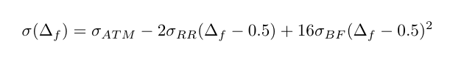
VOLATILITY SURFACE CALIBRATION
Implied Volatility
Market Quotes
Parabolic Interpolation
WE CALIBRATE THE SURFACE USING 3 TYPES OF MARKET QUOTES AND A PARABOLIC INTERPOLATION

Slide 14
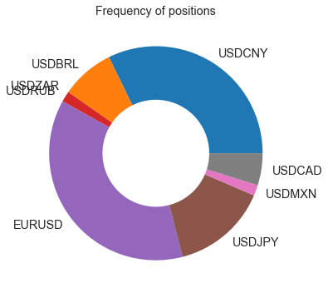
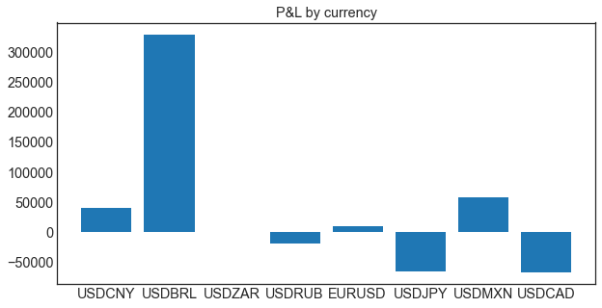
Option's Performance
The currency pair that had more times options position was the EURUSD, then the USDCNY
The curerncy pairs that had the better outcome was the USDBR, then the USDMXN.

Slide 15
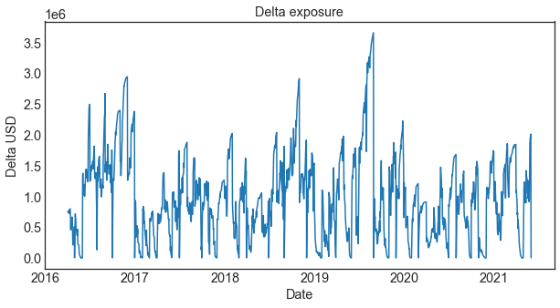
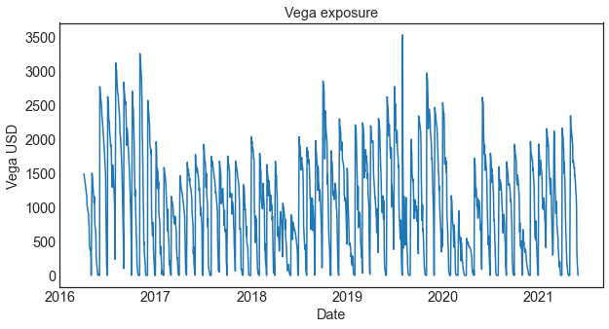
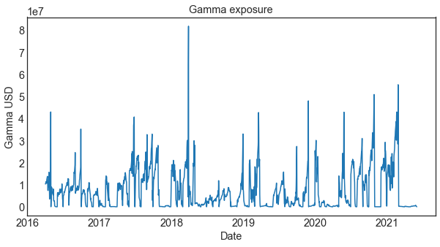
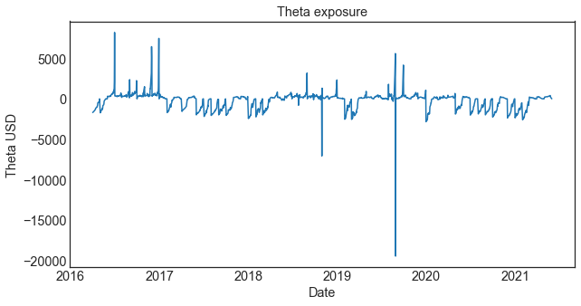
Option's market risk

Slide 16
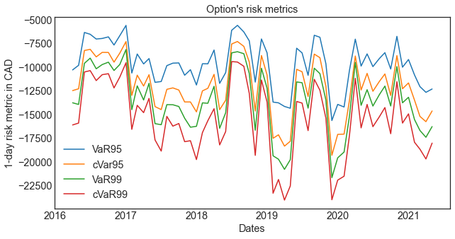
Option's risk metrics
The graph shows two types the VaR and cVaR, 95% and 99%, of options with a premium of 20,000 CAD.

Slide 17
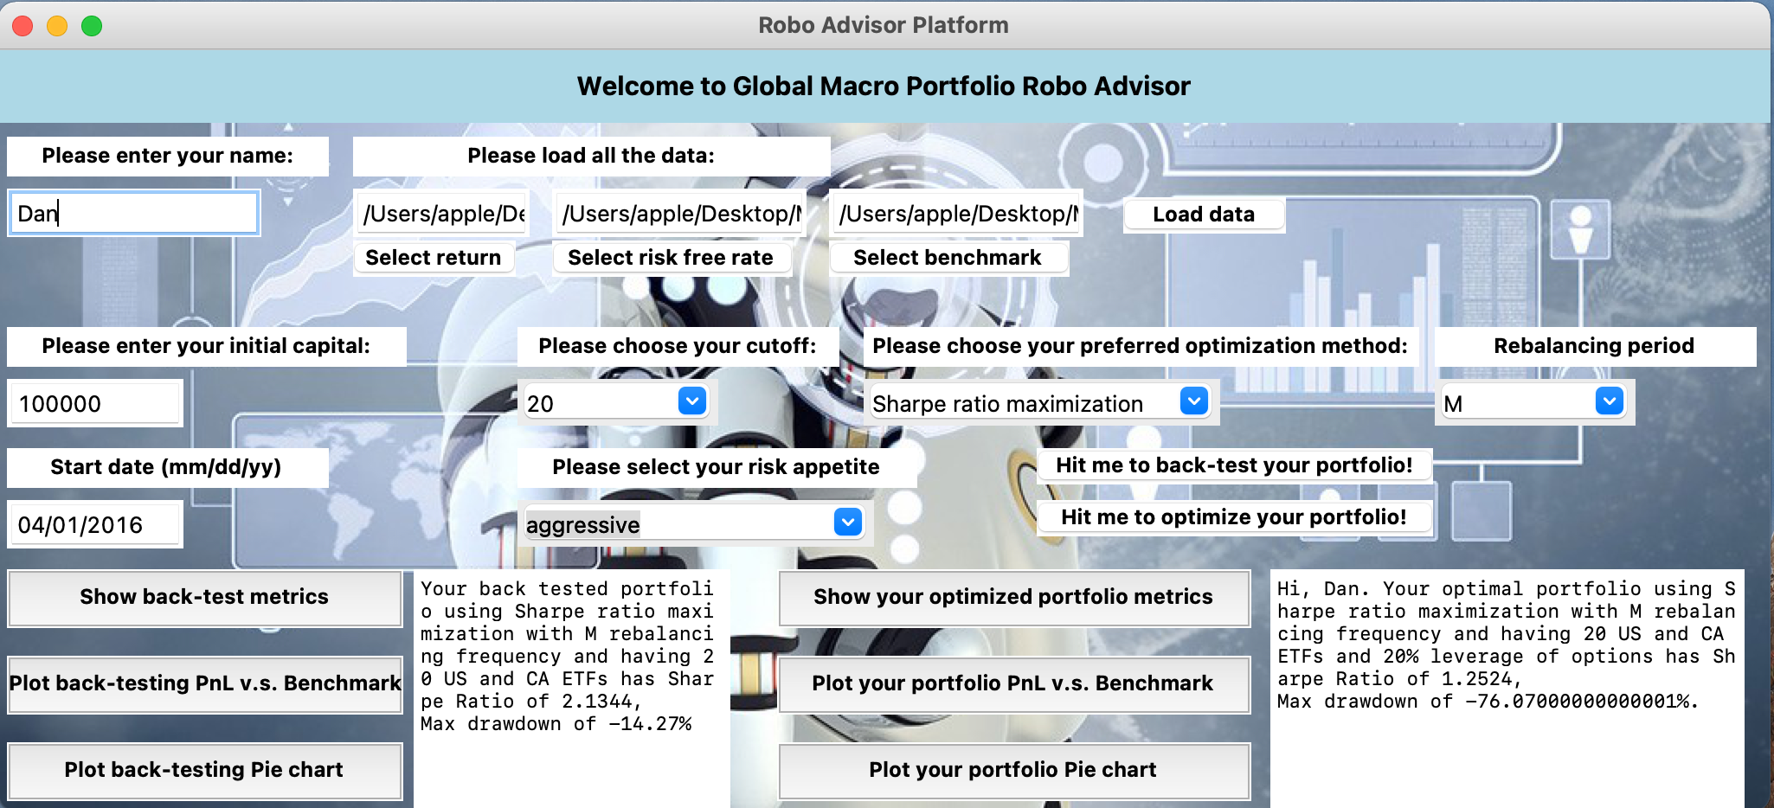
An automated robo-advisor user interface
User Information & appetite
access
Portfolio Back-test
Portfolio Performances
Served as back-test and portfolio performance simulation tool

Slide 18
Back-test results
10 assets/Geographical universe | Sharpe ratio | Max drawdown
Sharpe Ratio maximization | 0.8983 | -23.34%
Risk parity | -0.1884 | -51.15%
15 assets/Geographical universe | Sharpe ratio | Max drawdown
Sharpe Ratio maximization | 1.701 | -14.02%
Risk parity | 0.0625 | -44.8%
20 assets/Geographical universe | Sharpe ratio | Max drawdown
Sharpe Ratio maximization | 2.0458 | -14.28%
Risk parity | 0.2768 | -37.89%
Overall Sharpe ratio maximization provides more attractive Sharpe Ratio and max drawdowns
As we increase number of ETFs in each geographical universe, the metrics are strengthened
Final decision: Select Sharpe Ratio Maximization algorithm using 20 ETFs from each geographical universe
Risk metrics comparison of different strategy candidate

Slide 19
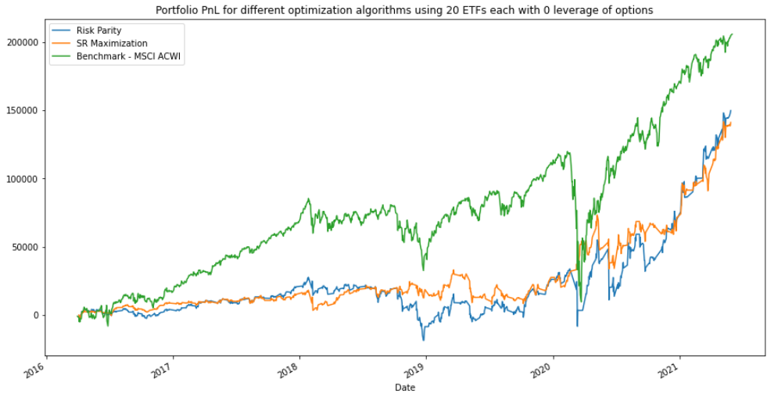
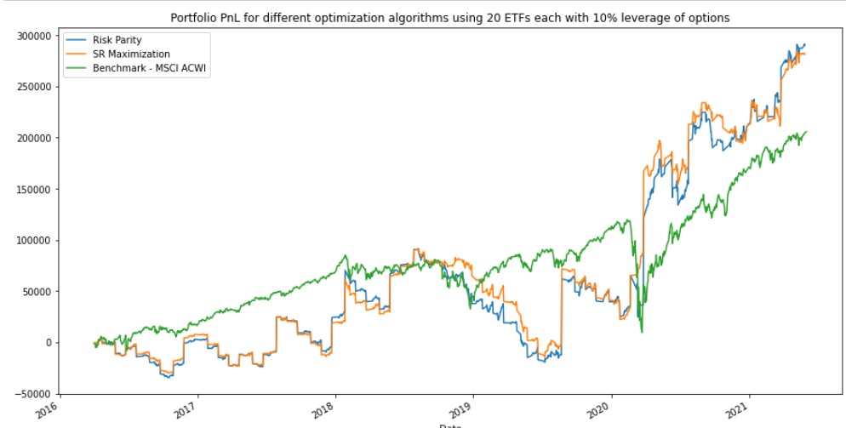
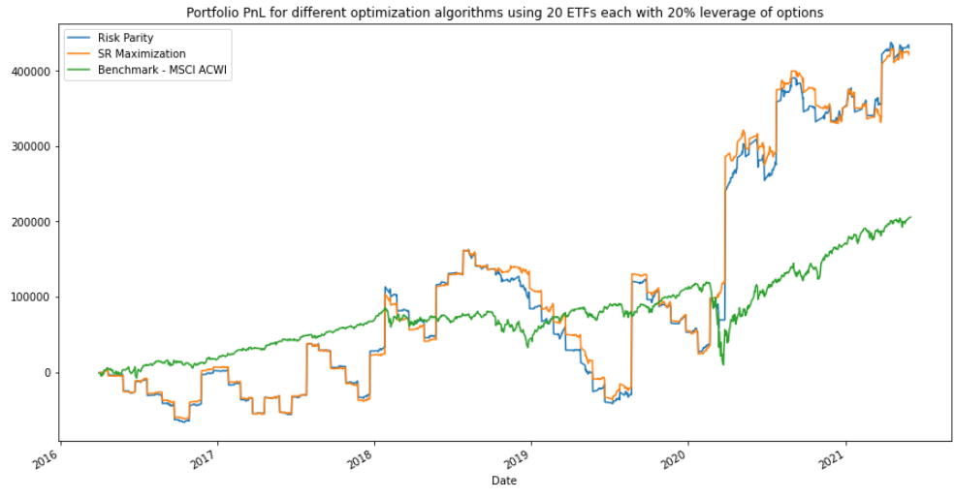
PortfOLIO results
20 assets/Geographical universe(conservative) | Sharpe ratio | Max drawdown
Option Leverage 0% | 2.0458 | -22.73%
20 assets/Geographical universe ( neutral) | Sharpe ratio | Max drawdown
Option Leverage 10% | 1.57 | -55.42%
20 assets/Geographical universe（aggressive) | Sharpe ratio | Max drawdown
Option Leverage 20% | 1.25 | -76.01%
AGGRESSIVE BUT PROFITABLE !
different strategy candidate

Slide 20
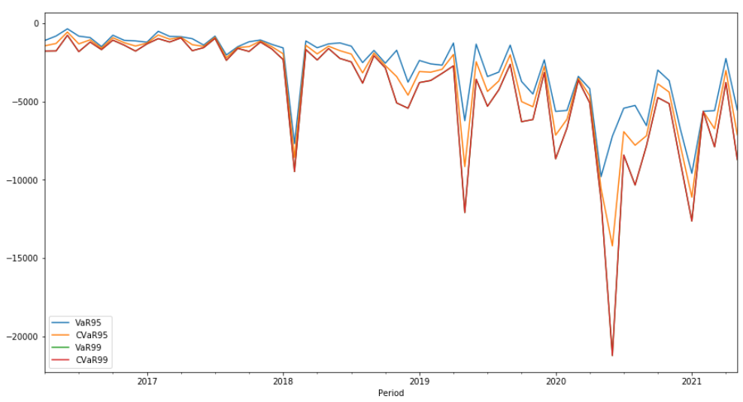
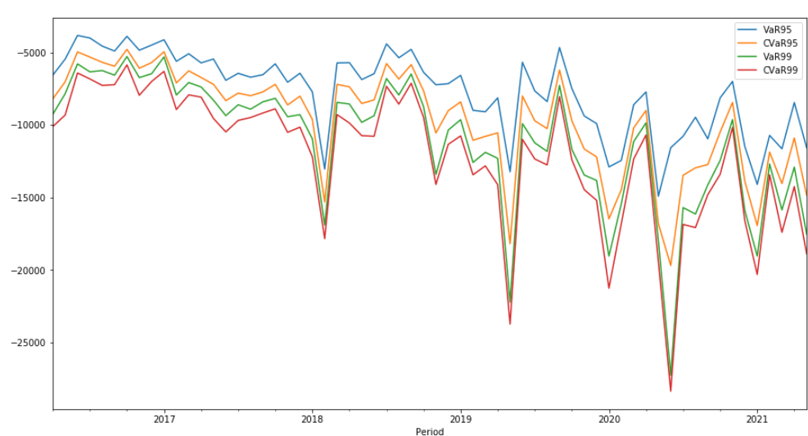
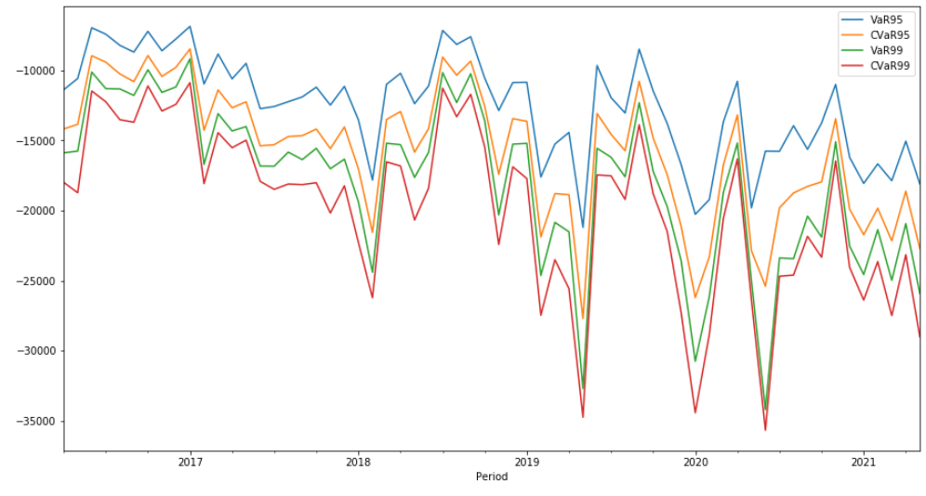
RISK metric results
0% leverage
10% leverage
20% leverage
COVID
Risk spiking
From Safe to aggressive

Slide 21
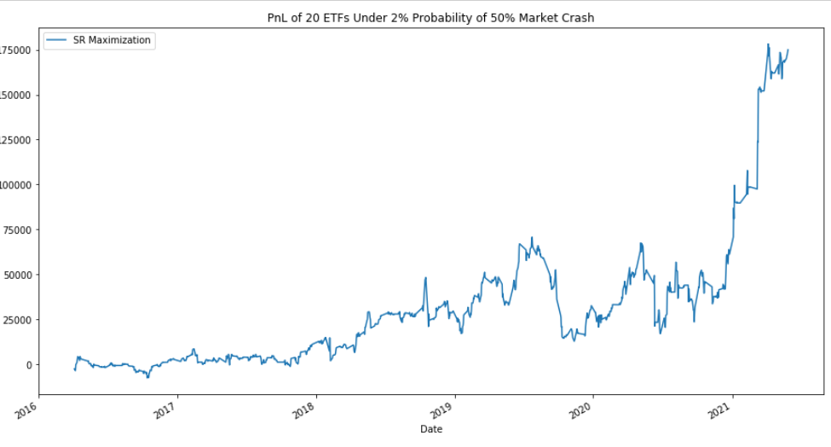
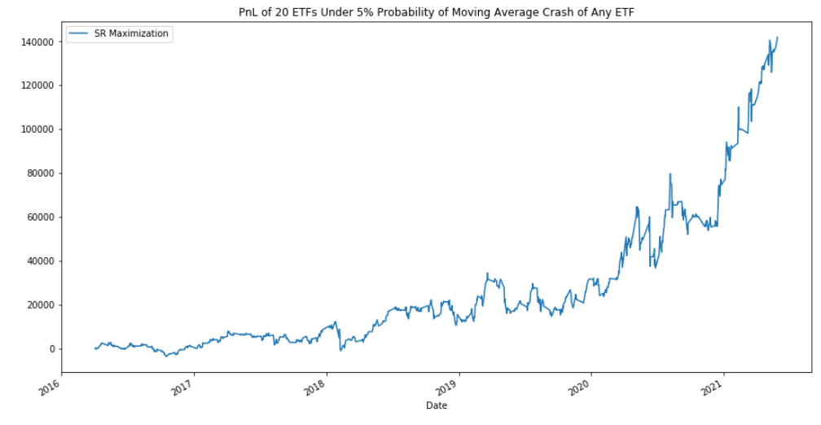
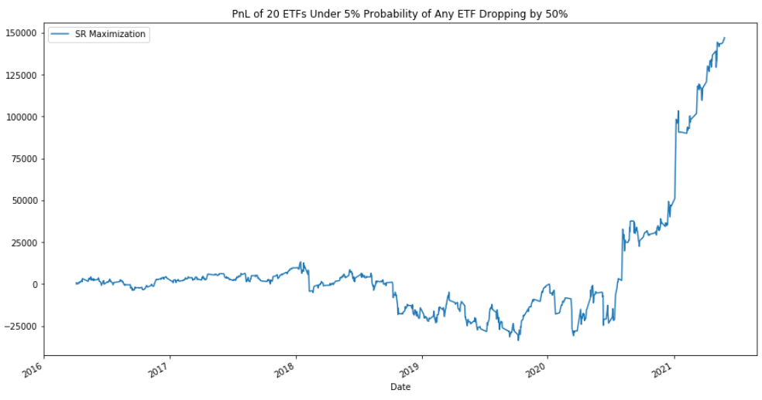
Scenario analysis
Individual crush
Market crush
MA crush
We are doing fine even under COVID!!!
3 different scenarios used as risk management

Slide 22
conclusion

